Slide 1
AVL Trees

Slide 2
AVL tree (Adelson-Velskii and Landis' tree, named after the inventors) is a self-balancing binary search tree.
An AVL tree is a binary search tree with a height balance property:
For each node v, the heights of the subtrees of v differ by at most 1.
A subtree of an AVL tree is also an AVL tree.
For each node of an AVL tree:
Balance factor = height(right subtree) - height(left subtree)
An AVL node can have a balance factor of -1, 0, or +1, otherwise it is unbalanced

Slide 3
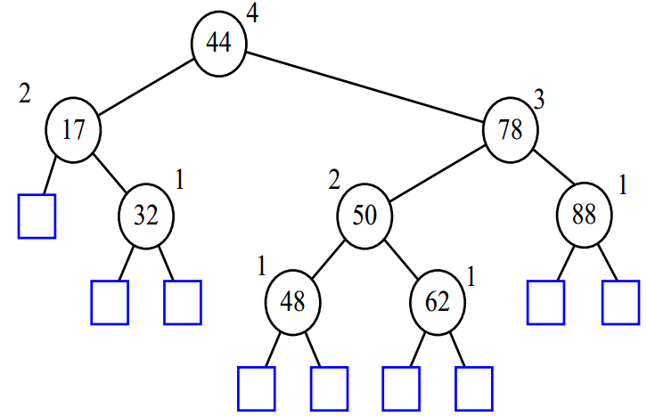

Slide 4
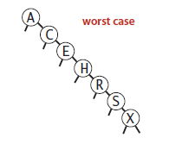
Insertion or deletion in an ordinary Binary Search Tree can cause large imbalances.
In the worst case searching an imbalanced Binary Search Tree is O(n).

Slide 5
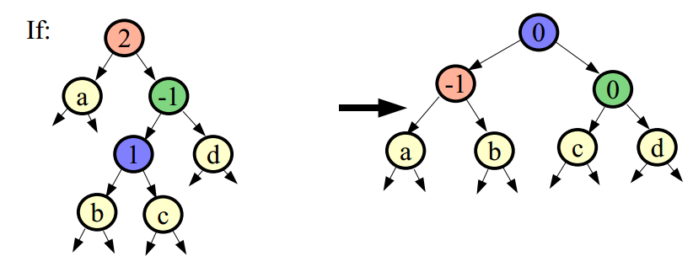
If a tree becomes imbalanced due to an insertion or deletion, we rotate the tree such that it becomes balanced again.
The height-balance property ensures that the height of an AVL tree with n nodes is O(log n).
Searching, insertion, and deletion are all O(log n).

Slide 6
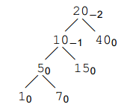
Recall the deﬁnition:
balance = depth(right tree) − depth(left tree).
At every node we compute the balance, displayed as subscript

Slide 7
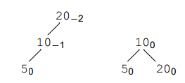
The tree below is left heavy as the balance is −2.
We also say that this is a left-left tree.
Executing a right rotation balances the tree.

Slide 8
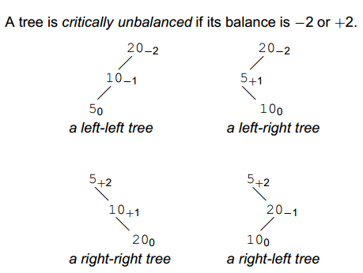

Slide 9
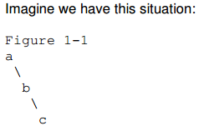
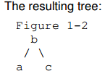
LEFT ROTATION
A right-right tree
To fix this, we must perform a left rotation, rooted at a. This is done in the following steps:
b becomes the new root.
a takes ownership of b's left child as its right child, or in this case, null.
b takes ownership of a as its left child.

Slide 10
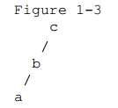
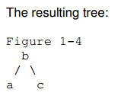
RIGHT ROTATION
A left-left tree.
To fix this, we will perform a single right rotation, rooted at C. This is done in the following steps:
b becomes the new root.
c takes ownership of b's right child, as its left child. In this case, that value is null.
b takes ownership of c, as it's right child.

Slide 11
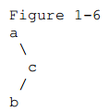
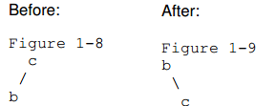
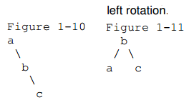
DOUBLE ROTATION
A right-left tree
We will perform a right rotation on the right subtree. We are not rotating on our current root. We are rotating on our right child. Think of our right subtree, isolated from our main tree, and perform a right rotation on it:
So our tree becomes a right-right tree. After performing a rotation on our right subtree, we have prepared our root to be rotated left.

Slide 12
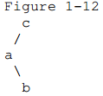
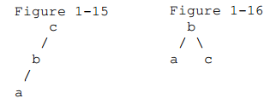
To balance a tree which has a left subtree, that is right heavy.
Or a left right tree.
The left subtree has a height of 2, and the right subtree has a height of 0. This makes the balance factor of our root node, c, equal to -2.
Balance factor = height(right subtree) - height(left subtree)
First make it a left-left tree, and then perform right rotation.

Slide 13
IF tree is right heavy
{
IF tree's right subtree is left heavy
{
Perform Double Left rotation
}
ELSE
{
Perform Single Left rotation
}
}
ELSE IF tree is left heavy
{
IF tree's left subtree is right heavy
{
Perform Double Right rotation
}
ELSE
{
Perform Single Right rotation
}
}

Slide 14
Insertions
Let the newly inserted node be w
Perform standard BST insert for w.
Starting from w, travel up and find the first unbalanced node. Let z be the first unbalanced node, y be the child of z that comes on the path from w to z and x be the grandchild of z that comes on the path from w to z.

Slide 15
//right rotate subtree rooted with y
Node rightRotate(Node y) {
Node x = y.left;
Node T2 = x.right;
// Perform rotation
x.right = y;
y.left = T2;
// Update heights
y.height = max(height(y.left), height(y.right)) + 1;
x.height = max(height(x.left), height(x.right)) + 1;
// Return new root
return x;
}
b becomes the new root.
c takes ownership of b's right child, as its left child.
b takes ownership of c, as it's right child.

Slide 16
//left rotate subtree rooted with x
Node leftRotate(Node x) {
Node y = x.right;
Node T2 = y.left;
// Perform rotation
y.left = x;
x.right = T2;
// Update heights
x.height = max(height(x.left), height(x.right)) + 1;
y.height = max(height(y.left), height(y.right)) + 1;
// Return new root
return y;
}

Slide 17
Balance of node N
int getBalance(Node N) {
if (N == null)
return 0;
return height(N.left) - height(N.right);
}

Slide 18
Node insert(Node node, int key) {
//Get the balance factor of this ancestor node to check whether this node became unbalanced */
int balance = getBalance(node);
// If this node becomes unbalanced, then there // are 4 cases
//Left Left Case
if (balance > 1 && key < node.left.key)
return rightRotate(node);
// Right Right Case
if (balance < -1 && key > node.right.key)
return leftRotate(node);
// Left Right Case
if (balance > 1 && key > node.left.key) {
node.left = leftRotate(node.left);
return rightRotate(node);
}
// Right Left Case
if (balance < -1 && key < node.right.key) {
node.right = rightRotate(node.right);
return leftRotate(node);
}
return node;
}

Slide 19
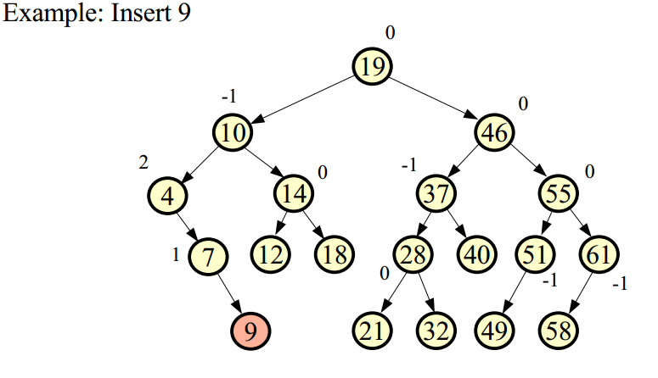
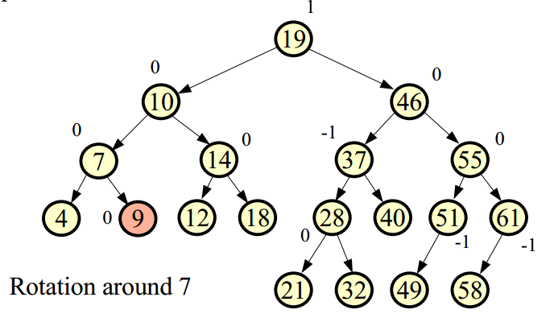

Slide 20
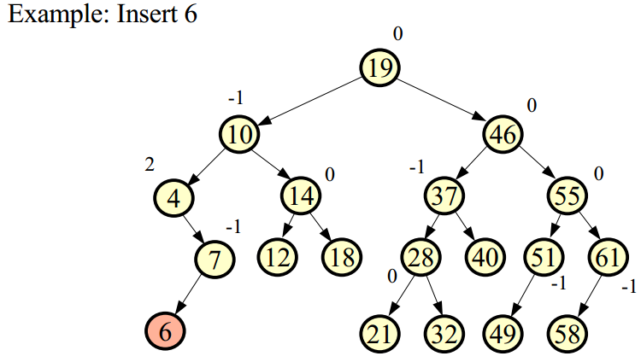
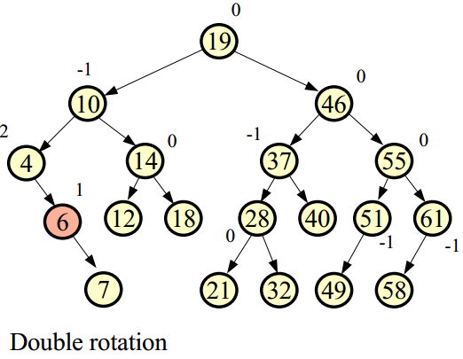

Slide 21
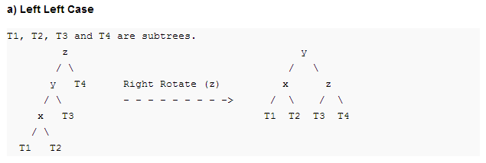

Slide 22
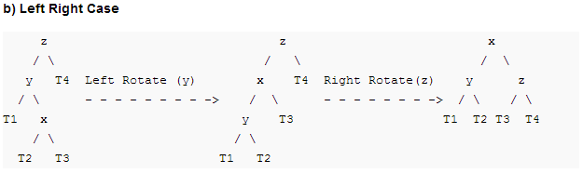

Slide 23
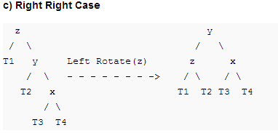

Slide 24
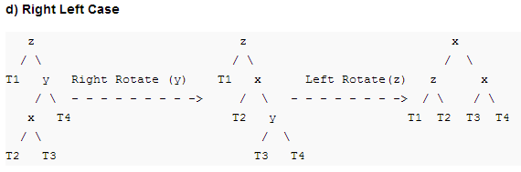

Slide 25
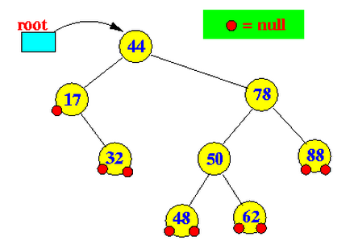
Deletion

Slide 26
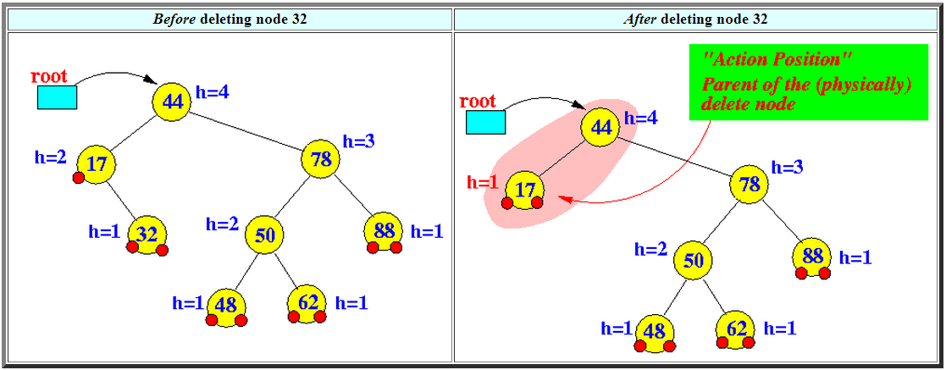

Slide 27
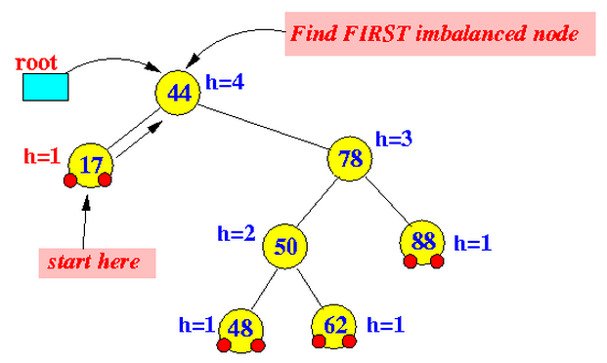

Slide 28
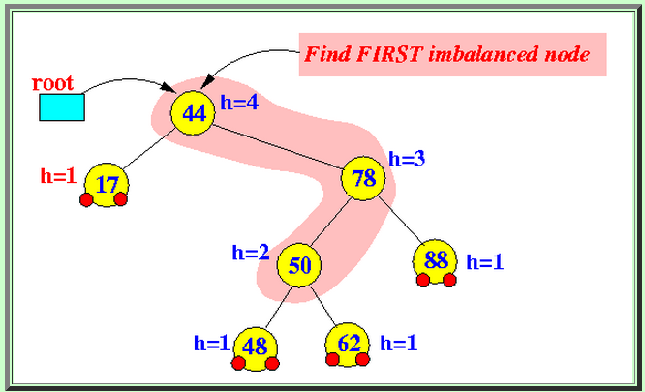

Slide 29
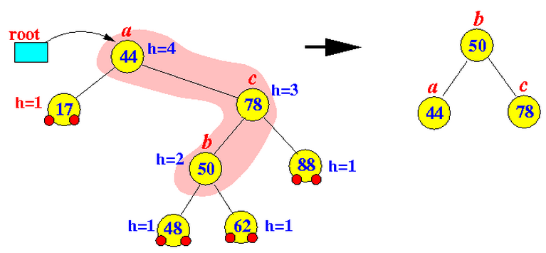
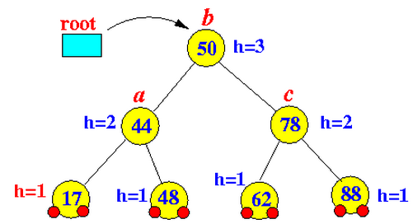
b becomes the new root.
a takes ownership of b's left child as its right child.
b takes ownership of a as its left child.

Slide 30
References
Wikipedia
http://pages.cs.wisc.edu/~paton/readings/liblitVersion/AVL-Tree-Rotations.pdf
http://gauss.ececs.uc.edu/Courses/C228/LectureNotes/Trees/BalancedBinaries/avl.pdf
http://www.dcs.gla.ac.uk/~pat/52233/slides/AVLTrees1x1.pdf
http://homepages.math.uic.edu/~jan/mcs360/balancing_search_trees.pdf
http://cs-study.blogspot.com/2012/11/cases-of-rotation-of-avl-tree.html
http://www.mathcs.emory.edu/~cheung/Courses/323/Syllabus/Trees/AVL-delete.html

